Slide 1
Credit Card Fraud Detection Using Machine Learning and Neural Networks Jayana Sarma, Nayana Nagarajappa

Slide 2
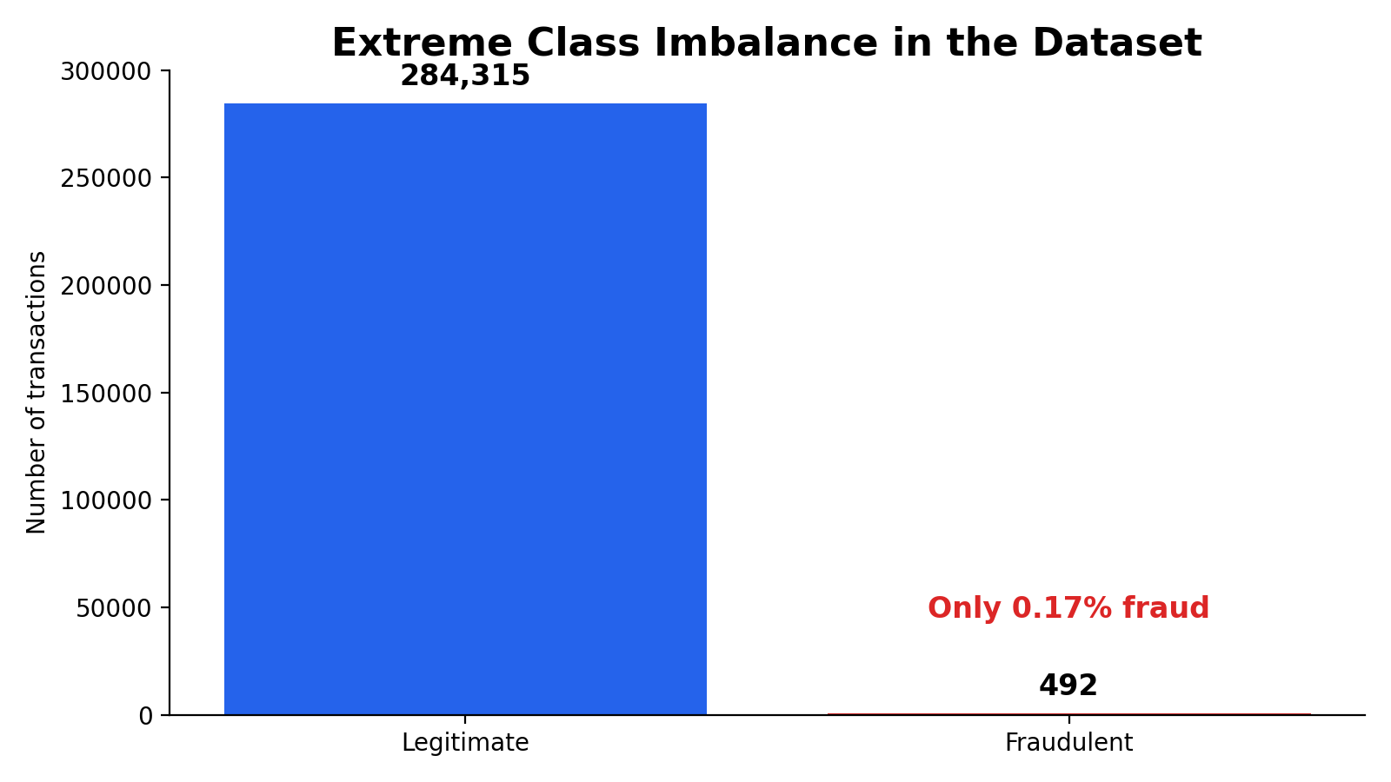
Application Context
Why Credit Card Fraud Detection Matters
Credit card fraud detection is a real-world binary classification problem where the goal is to identify whether a transaction is:
Legitimate
Fraudulent
Key challenge:
A model can achieve very high accuracy by predicting almost every transaction as legitimate, but that would not be useful for detecting fraud.

Slide 3
Dataset and preprocessing
We used the Kaggle Credit Card Fraud Detection dataset. Anonymized transaction features were prepared for supervised binary classification.
Input columns
Target
Sampling
Time, Amount, V1–V28
Class: 0 = legit, 1 = fraud
Stratified train / validation / test
Preprocessing and modeling setup
App-ready feature contract
Checked feature structure and class imbalance
Scaled numeric features for models requiring preprocessing
Compared baseline, tree-based, boosting, and neural network models
The app expects the same training columns and reorders them before prediction, reducing training-serving mismatch.
Consistent preprocessing prevents training-serving mismatch.

Slide 4
Solution workflow
The project was built as an end-to-end modeling and demo pipeline.
1
2
3
4
5
Explore
Preprocess
Train
Tune
Demo
Class imbalance
Feature overview
Scale features
Create splits
Baseline + RF
NN + XGBoost
Adjust threshold
Optimize F1
Upload CSV
Predict fraud
Models compared
Logistic
Balanced Logistic
Random Forest
Neural Network
Improved NN
XGBoost
RF Threshold 0.3

Slide 5
Evaluation metrics
Because fraud cases are rare, accuracy can be misleading.
We used these metrics:
1
Precision
2
Recall
Among predicted fraud cases, how many were truly fraud?
Among actual fraud cases, how many did the model catch?
3
F1-score
4
PR-AUC
Balances precision and recall; used for final selection.
Especially useful when the positive class is rare.
Critical tradeoff
Higher recall catches more fraud, higher precision reduces false alarms and F1-score balances both.

Slide 6
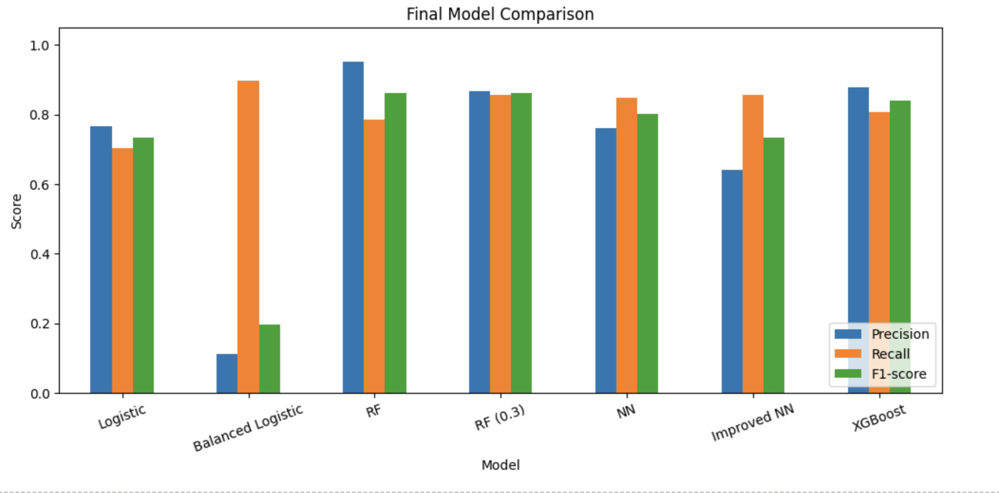
Results: vertical progress
We compared model performance across each stage of development, from baselines to tuned models.
Key observations
Balanced Logistic had high recall but very low precision.
Random Forest and XGBoost produced the strongest results.
Threshold tuning improved Random Forest performance.
RF threshold 0.3 achieved the best F1-score.
Best F1
RF threshold 0.3

Slide 7
Horizontal results: baseline vs advanced models
We compared simple reference models against stronger tree-based, boosting, and neural network approaches.
Model families compared
Main observations
Baseline
Logistic Regression Balanced Logistic
Tree-based
Random Forest RF threshold 0.3
Baseline models: useful reference point, but weaker overall.
Balanced Logistic: high recall, but too many false positives.
Random Forest + XGBoost: strongest overall model families.
Boosting
XGBoost Strong precision and PR-AUC
Neural Net
Original NN Improved NN
Neural networks: good recall, but lower precision on this tabular dataset.
Final choice: Random Forest with threshold 0.3

Slide 8
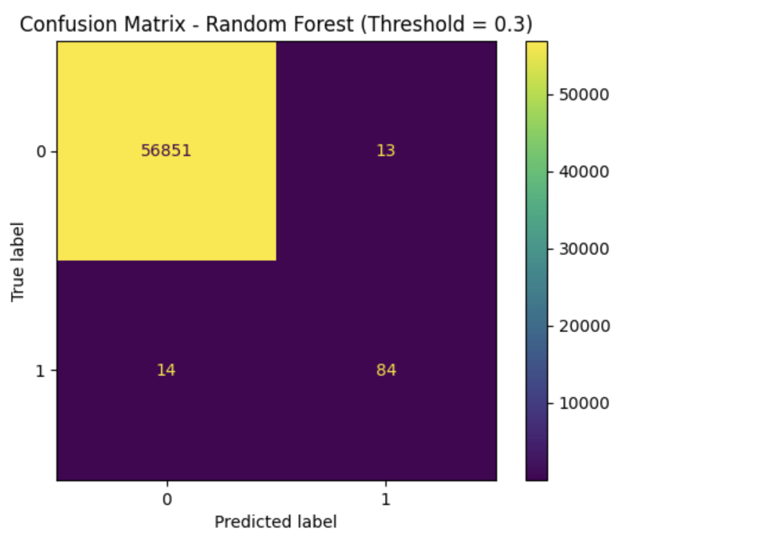
Final model selection
Random Forest with a 0.3 threshold gave the best precision-recall balance.
Precision
Recall
F1-score
Selected model
0.8660
0.8571
0.8615
Random Forest
Threshold = 0.3
Why it was selected
Highest F1-score among tested models
Strong fraud recall without too many false alarms
Reliable for tabular transaction data
Simple to save and use in the Streamlit app
Model
Precision
Recall
F1
Interpretation: catches fraud while controlling false alarms.

Slide 9
Critical component: threshold-based prediction
The app turns model probabilities into decisions using the selected 0.3 threshold.
What happens in the app
Code walkthrough
data_scaled = scaler.transform(data_for_prediction)
fraud_probabilities = model.predict_proba(data_scaled)[:, 1]
predictions = (fraud_probabilities >= threshold).astype(int)
1
Scale uploaded data
2
Predict fraud probability
3
Apply threshold 0.3
Key idea
4
Label transaction
The model outputs a probability first. The threshold controls when that probability becomes a fraud alert.
Decision rule
Probability >= 0.3 -> Fraudulent
Probability < 0.3 -> Legitimate

Slide 10
App Demonstration
Demo App
The final project includes a Streamlit app for fraud prediction.
App features:
Upload CSV transaction data
Preview uploaded data
Show file summary
Predict fraud probabilities
Display predicted fraud and legitimate counts
Compare actual vs predicted fraud count if Class is included
Preview predicted fraud cases
Download full prediction results
The app interface includes upload, summary, prediction, visualization, and download sections

Slide 11
Limitations and future work
The current solution works as a project demo, with clear paths for improvement.
Current limitations
Future improvements
Features are anonymized, so interpretation is limited
App expects the same feature format as training data
Model was trained on historical transactions only
Fraud patterns can change over time
Add real-time fraud detection support
Monitor performance drift over time
Try SMOTE or other resampling methods
Use SHAP values for model explainability
Deploy the app online for easier access
Main takeaway: fraud detection needs threshold-aware evaluation, not just accuracy.

Slide 12
Thank You

